Slide 1
Optimizing for Cost in the Cloud
Miles Ward - Solutions Architect
@milesward

Slide 2
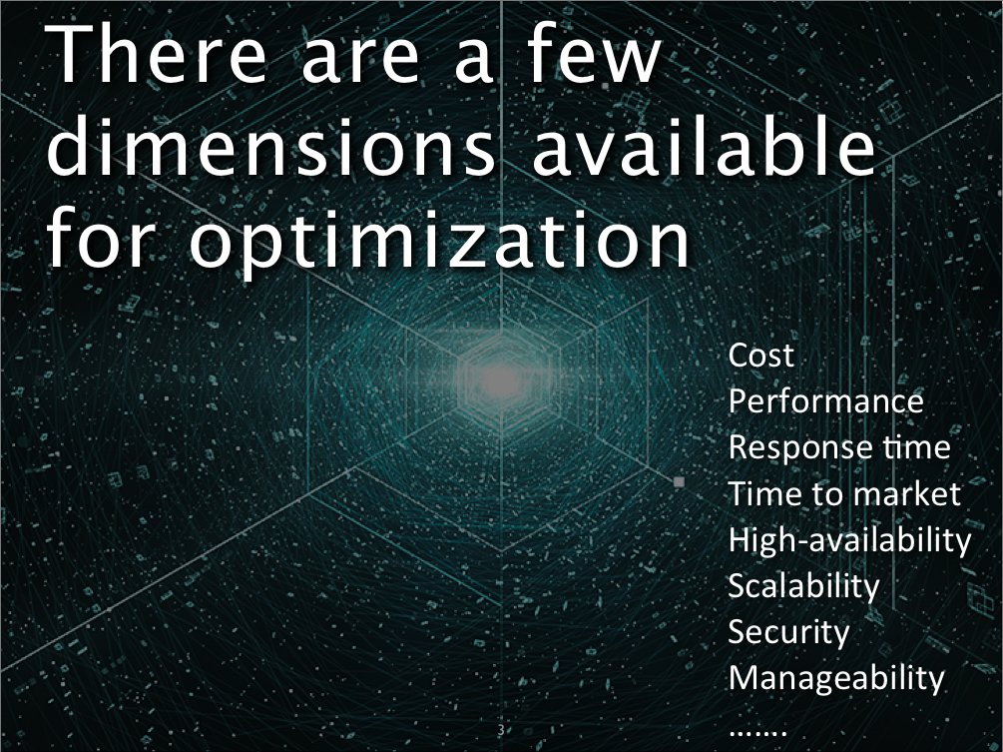

Slide 3
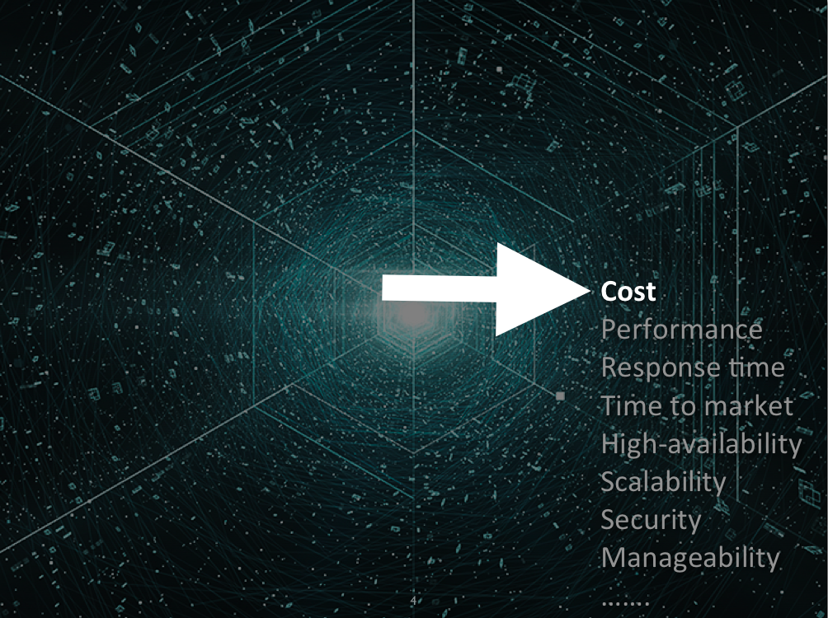

Slide 4
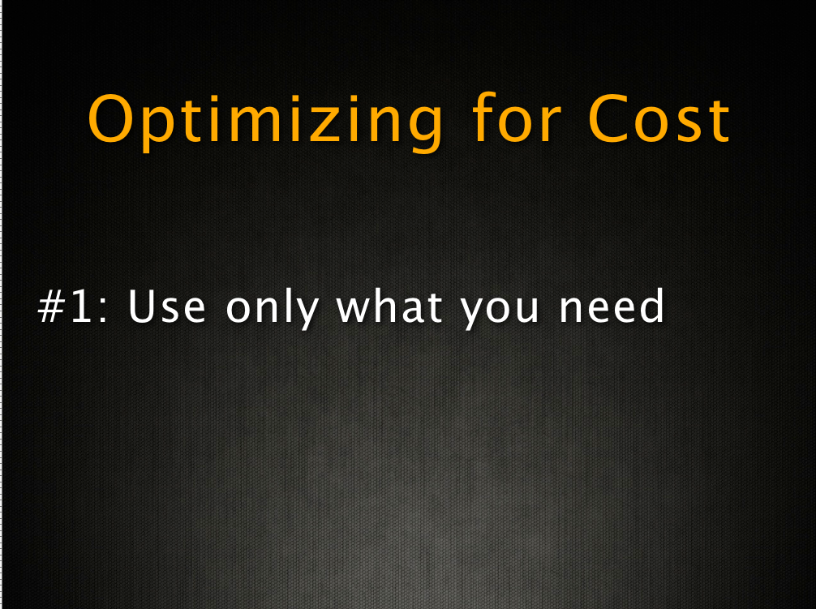

Slide 5

“I said turn the
lights off!!”
Turn off what you don’t need (automatically)
Notes:
Our strategy of pricing each service independently gives you tremendous flexibility to choose the services you need for each project and
to pay only for what you use

Slide 6
25% Savings
Optimize by the time of day
Notes:
Build websites that sleep at night. Build machines only live when you need it

Slide 7
Auto scaling : Types of Scaling
Scaling by Schedule
Use Scheduled Actions in Auto Scaling Service
Date
Time
Min and Max of Auto Scaling Group Size
You can create up to 125 actions, scheduled up to 31 days into the future, for each of your auto scaling groups. This gives you the ability to scale up to four times a day for a month.
Scaling by Policy
Scaling up Policy - Double the group size
Scaling down Policy - Decrement by 1
Scale By Hand
Not so auto, but still better than nothing!
Notes:
Perhaps you expect a lot of traffic as part of a planned announcement and you want to increase the size of your EC2 fleet just ahead of your press release. Maybe your site is busy once a day because you have a daily deal or a daily special, or only on weekends when people are at sporting events. Or maybe you run a college registration site and you want to scale up during day and evening hours for the four-day registration period.

Slide 8
www.MyWebSite.com
(dynamic data)
Amazon Route 53
(DNS)
media.MyWebSite.com
(static data)
Elastic Load
Balancer
Availability Zone #1
Auto Scaling group : Web Tier
Availability Zone #2
Amazon
CloudFront
Amazon EC2
Auto Scaling group : App Tier
Amazon RDS
Amazon
RDS
Amazon S3
Notes:
Shrink your server fleet from 6 to 2 at night and bring back

Slide 9
50% Savings
Weekly CPU Load
Optimize during a year

Slide 10
75% Savings
Daily CPU Load
Optimize during a month

Slide 11

Optimize by using “Reminder scripts”
Disassociate your unused EIPs
Delete unassociated EBS volumes
Delete older EBS snapshots
Leverage S3 Object expiration

Slide 12

Tip – Instance Optimizer
Free Memory
Free CPU
Free HDD
At 1-min intervals
PUT
2 weeks
Amazon CloudWatch
Alarm
Instance
Custom Metrics
“You could save a bunch of money by switching
to a smaller instance, Click on CloudFormation Script to
Save”

Slide 13
Optimize by choosing the Right Instance Type
Choose the EC2 instance type that best matches the resources required by the application
Start with memory requirements and architecture type (32bit or 64-bit)
Then choose the closest number of virtual cores required
Then iterate based on actual performance!!
Scaling across AZs
Smaller sizes give more granularity for deploying to multiple AZs
Notes:
For example, if the application always scales 2 larges in each AZ, there is pretty much no difference between this approach and 1 extra large in each AZ. However it would be safer for the customer to scale 1 large in 2 AZs rather than 1 extra large in 1 AZ (and cheaper than 2 extra larges).

Slide 14
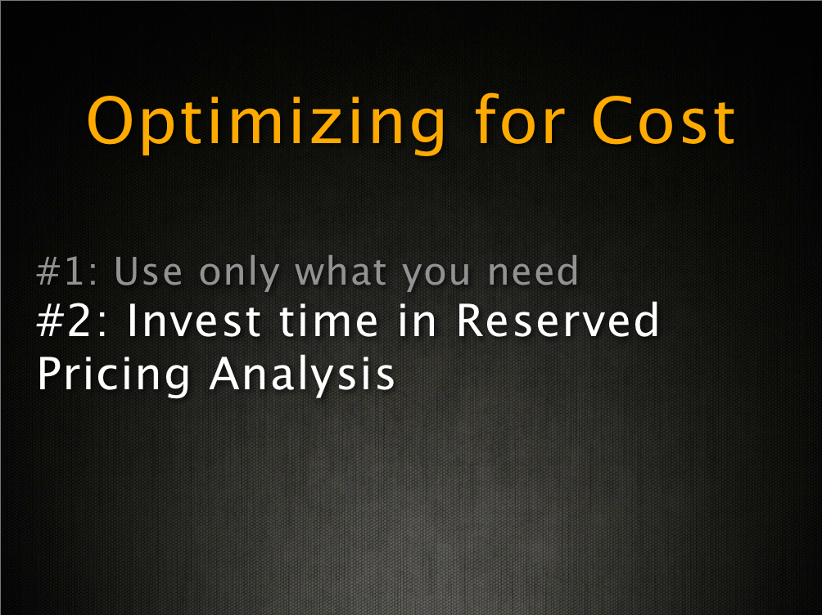

Slide 15
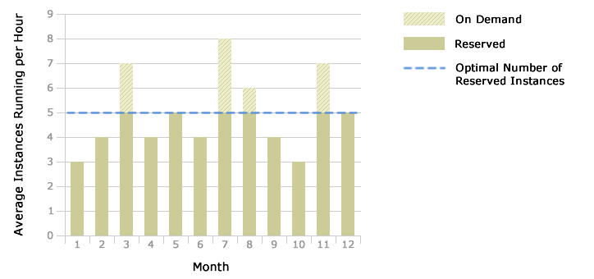
Your Best Option: Reserved + On-Demand

Slide 16
Save more when you reserve
On-demand Instances
Reserved Instances
Pay as you go
One time low upfront fee + Pay as you go
$23 for 1 year term and $0.005/Hour
Starts from $0.02/Hour
1-year and 3-year terms
Heavy Utilization RI
Medium Utilization RI
Light Utilization RI
That’s ½ a cent an hour…

Slide 17
m2.xlarge running Linux in US-East Region
over 3 Year period
Break-even point
Utilization | Sweet Spot | Feature | Savings over On-Demand
<10% | On-Demand | No Upfront Commitment
10% - 40% | Light Utilization RI | Ideal for Disaster Recovery | Up to 56% (3-Year)
40% - 75% | Medium Utilization RI | Standard Reserved Capacity | Up to 66% (3-Year)
>75% | Heavy Utilization RI | Lowest Total Cost Ideal for Baseline Servers | Up to 71% (3-Year)

Slide 18
Recommendations
Steady State Usage Pattern
For 100% utilization
If you plan on running for at least 6 months, invest in RI for 1-year term
If you plan on running for at least 8.7 months, invest in RI for 3-year term
Spiky Predictable Usage Pattern
Baseline
3-Year Heavy RI (for maximum savings over on-demand)
1-Year Light RI (for lowest upfront commitment) + savings over on-demand
Peak: On-Demand
Uncertain and unpredictable Usage Pattern
Baseline: 3-Year Heavy RIs
Median: 1-Year or 3-Year Light RIs
Peak: On-Demand
Notes:
1 or 3 years is our commitment to the customer not theirs to us. Therefore, if a customer plans on running for at least 8 months the only sensible purchase is the 3 year.

Slide 19
Example: Simple 3-Tier Web Application
Description | Option 1 | Option 2 | Option 3 | Option 4
2 Web servers | 2 On-Demand | 2 On-Demand | 1 On-Demand and 1 Reserved Medium Utilization | 1 On-Demand and 1 Reserved Light Utilization
2 App servers | 2 On-Demand | 2 On-Demand | 1 On-Demand and 1 Reserved Medium Utilization | 1 On-Demand and 1 Reserved Light Utilization
2 Database servers | 2 On-Demand | 2 Reserved Medium Utilization | 2 Reserved Medium Utilization | 2 Reserved Heavy Utilization

Slide 20
Example: Simple 3-Tier Web Application
Savings |  | Option 1 | Option 2 | Option 3 | Option 4
 |  | Calculator | Calculator | Calculator | Calculator
Monthly Cost |  | $702.72 | $374.78 | $256.20 | $238.63
One-Time Cost | 1 Year Term | - | $1280.00 | $1600.00 | $1698.00
 | 3 Year Term | - | $2000.00 | $2500.00 | $2612..60
Total Cost | 1 Year Term (x12) | $8432.64 | $5777.36 | $4674.40 | $4561.56
 | 3 Year Term (x36) | $25297.92 | $15492.08 | $11723.20 | $11203.28
Savings (Over Option 1) | 1 Year Term | n/a | 32% | 44% | 45%
 | 3 Year Term | n/a | 39% | 54% | 54%

Slide 21
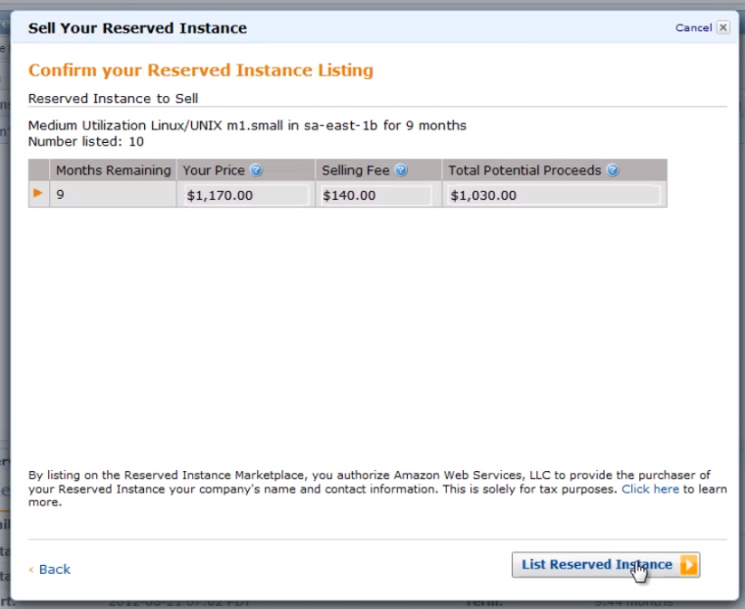
Wait! Isn’t a Reserved Instance inelastic?
RI Marketplace = Elastic Savings

Slide 22
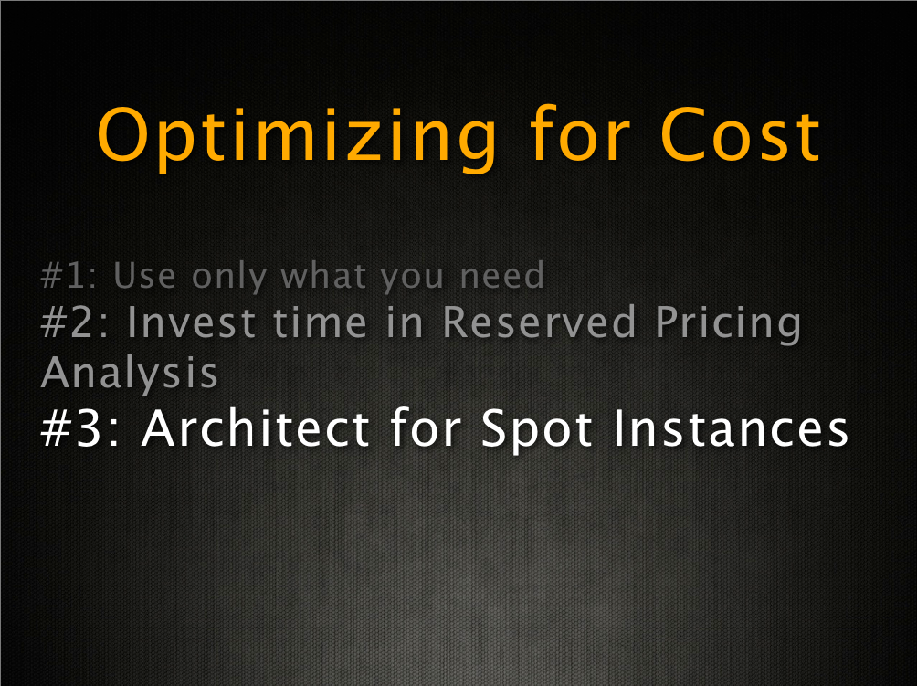

Slide 23
Optimize by using Spot Instances
On-demand Instances
Reserved Instances
Spot Instances
Pay as you go
One time low upfront fee + Pay as you go
Requested Bid Price and Pay as you go
$0.005/Hour as of today at 9 AM
$23 for 1 year term and $0.01/Hour
Starts from $0.02/Hour
Heavy Utilization RI
Medium Utilization RI
Light Utilization RI
1-year and 3-year terms

Slide 24
Spot Use cases
Use Case | Types of Applications
Batch Processing | Generic background processing (scale out computing)
Hadoop | Hadoop/MapReduce processing type jobs (e.g. Search, Big Data, etc.)
Scientific Computing | Scientific trials/simulations/analysis in chemistry, physics, and biology
Video and Image Processing/Rendering | Transform videos into specific formats
Testing | Provide testing of software, web sites, etc
Web/Data Crawling | Analyzing data and processing it
Financial | Hedgefund analytics, energy trading, etc
HPC | Utilize HPC servers to do embarrassingly parallel jobs
Cheap Compute | Backend servers for online games

Slide 25
Spot Use cases
Use Case | Types of Applications
Batch Processing | Generic background processing (scale out computing)
Hadoop | Hadoop/MapReduce processing type jobs (e.g. Search, Big Data, etc.)
Scientific Computing | Scientific trials/simulations/analysis in chemistry, physics, and biology
Video and Image Processing/Rendering | Transform videos into specific formats
Testing | Provide testing of software, web sites, etc
Web/Data Crawling | Analyzing data and processing it
Financial | Hedgefund analytics, energy trading, etc
HPC | Utilize HPC servers to do embarrassingly parallel jobs
Cheap Compute | Backend servers for online games

Slide 26
Spot Use cases
Use Case | Types of Applications
Batch Processing | Generic background processing (scale out computing)
Hadoop | Hadoop/MapReduce processing type jobs (e.g. Search, Big Data, etc.)
Scientific Computing | Scientific trials/simulations/analysis in chemistry, physics, and biology
Video and Image Processing/Rendering | Transform videos into specific formats
Testing | Provide testing of software, web sites, etc
Web/Data Crawling | Analyzing data and processing it
Financial | Hedgefund analytics, energy trading, etc
HPC | Utilize HPC servers to do embarrassingly parallel jobs
Cheap Compute | Backend servers for online games

Slide 27
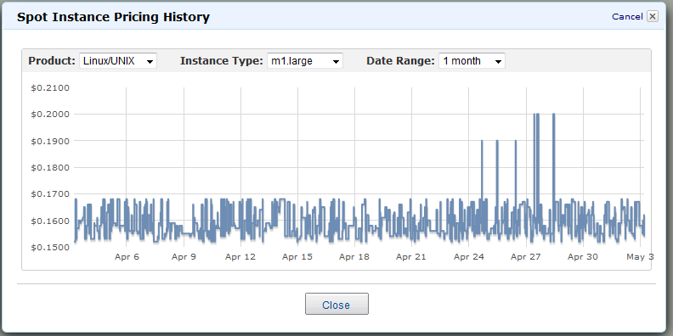
Save more money by using Spot Instances
Reserved Hourly Price > Spot Price < On-Demand Price

Slide 28
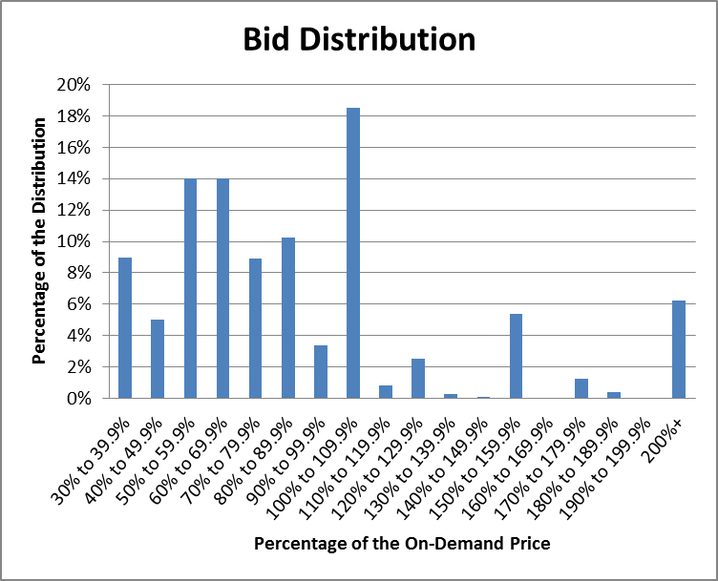
Typical Spot Bidding Strategies
Bid near the Reserved Hourly Price
Bid above the Spot Price History
Bid near On-Demand Price
Bid above the On-Demand Price
Notes:
1
Engineered application towards a cost
Set low maximum bid price to minimize costs
Were comfortable if process ran longer or jobs were re-run
Did not pay for hour if they are interrupted
2
Price Set 10% above Average Price Last Hour
Maximum price threshold of 80% of On-Demand Price
One time spot requests; one instance per request; across all availability zones
Not more than 10 open Spot requests at any time
Spot requests expire in 10 minute
Launch Spot instances first and then on-demand instances if you don’t get the spot instances in under 15 minutes
3
Bid around the On-Demand price
Use On-Demand instance when Spot Price exceeds On-Demand price (or slightly higher)
May pay more some hours, but on average they pay significantly less
This bidding strategy ensures a discount over On-Demand
4
Bid around the On-Demand price
Use On-Demand instance when Spot Price exceeds On-Demand price (or slightly higher)
May pay more some hours, but on average they pay significantly less
This bidding strategy ensures a discount over On-Demand

Slide 29

Managing Interruption

Slide 30
Architecting for Spot Instances : Best Practices
Manage interruption
Split up your work into small increments
Checkpointing: Save your work frequently and periodically
Test Your Application
Track when Spot Instances Start and Stop
Spot Requests
Use Persistent Requests for continuous tasks
Choose maximum price for your requests
Notes:
Save Your Work Frequently: Because Spot Instances can be terminated with no warning, it is important
to build your applications in a way that allows you to make progress even if your application is
interrupted. There are many ways to accomplish this, two of which are adding checkpoints to your
application or splitting your work into small increments.
Add Checkpoints: Depending on fluctuations in the Spot Price caused by changes in the supply or
demand for Spot capacity, Spot Instance requests may not be fulfilled immediately and may be
terminated without warning. In order to protect your work from potential interruptions, we
recommend inserting regular checkpoints to save your work periodically. One way to do this is by saving
all of your data to an Amazon EBS volume. Another approach is to run your instances using Amazon EBS-backed AMIs. By setting the
DeleteOnTermination flag to false as part of your launch request, the Amazon EBS volume used as the
instance’s root partition will persist after instance termination, and you can recover all of the data saved
to that volume. You can read more details on the use of Amazon EBS-backed AMIs here.
Note: When using this technique with a persistent request, bear in mind that a new EBS volume
will be created for each new Spot Instance.
Split up Your Work: Another best practice is to split your workload into small increments if possible.
Using Amazon SQS, you can queue up work increments and keep track of what work has already been
done (as in the example from the previous section). When using this approach, ensure that processing a
unit of work is idempotent (can be safely processed multiple times) to ensure that resuming an
interrupted task doesn’t cause problems. You can do this by enqueuing a message to your Amazon SQS queue for each increment of work. You
can then build an AMI that, when run, discovers the queue from which to pull its work. Discovery can be
done by building it into the AMI, passing in user data or by storing the configuration remotely (for
example in Amazon SimpleDB or Amazon S3), which will tell the AMI in which queue to look.
More details on using Amazon SQS with Amazon EC2 and a detailed walkthrough on how to set up this
type of architecture can be found here.
Test Your Application: When using Spot Instances, it is important to make sure that your application is
fault tolerant and will correctly handle interruptions. While we attempt to cleanly terminate your
instances, your application should be prepared to deal with sudden shutdowns. You can test your
application by running an On-Demand Instance and then terminating it. This can help you to determine
whether your application is sufficiently fault tolerant and is able to handle unexpected interruptions.
18
Minimize Group Instance Launches: There are two options for launching instances together in a cluster.
The Launch Group is a request option that ensures your instances will be launched and terminated
simultaneously. The Availability Zone Group is a second request option that ensures your instances will
be launched together in one Availability Zone. Although they may be necessary for some applications,
avoiding these restrictions whenever possible will increase the chances of your request being fulfilled.
When Launch Groups are required, try to minimize the group size because larger groups have a lower
chance of being fulfilled. Additionally whenever possible, try to avoid specifying a specific Availability
Zone in order to increase your chances of successfully launching.
Use Persistent Requests for Continuous Tasks: Spot Instance Requests can be one-time or persistent. A
one-time request will only be satisfied once; a persistent request will remain in consideration after each
instance termination. This means that after your request has been satisfied and your instance has been
terminated—by you or by Amazon EC2—your request will be submitted again automatically with the
same parameters as your initial request. A persistent request will continue submitting the request until
you cancel it. These requests can be helpful if you have continuous work that can be stopped and
resumed, such as data processing or video rendering. We recommend that you revisit these requests
from time to time to examine whether or not you want to change your maximum price or the AMI.
Changing parameters will require that you cancel your existing request and resubmit a new request.
Note: Terminating your instance is not the same as cancelling a persistent request. If you
terminate your instance without cancelling your persistent request, Amazon EC2 will
automatically launch a replacement Spot Instance given that your maximum price is above the
current Spot Price.
Track when Spot Instances Start and Stop: The simplest way to know the current status of your Spot
Instances is to either poll the DescribeSpotInstanceRequests API or view the status of your instance using
the AWS Management Console. By polling the DescribeSpotInstanceRequests at whatever frequency you
desire (e.g. every ten minutes), you can look for state changes to your requests. This will tell you when a
request is successful, because it will change from “open” to “active” and it will have an associated
instance ID. You can use this same approach to detect terminations by checking to see if the “instance
id” field disappears.
You can also use Amazon SQS to create your own notifications. One way of doing this is to create an AMI
that has a start-up script that enqueues a message on an Amazon SQS queue. You can take the same
approach to detect when a Spot Instance begins the process of shutting down.
For instructions on how to build your own AMI, please see the Amazon EC2 User Guide located here.
Access Large Pools of Compute Capacity: Spot Instances can be used to help you meet occasional needs
for large amounts of compute capacity (note that the default limit for Spot Instances is 100 versus the
default limit of 20 for On-Demand Instances.) If your needs are urgent, you can specify a high maximum
price (possibly even higher than the On-Demand price), which will raise your request’s relative priority
and allow you to gain access to as much immediate capacity as possible given other requests and the
19
Spot Instance capacity available at the time. While Spot Instances are generally not suitable for steadystate
tasks such as serving web content, they can be used as a valuable source of instance capacity even
for steady state applications when applications have urgent computing needs due to unanticipated or
short-term demand spikes.

Slide 31


Optimizing Video Transcoding Workloads
Free Offering
Optimize for reducing cost
Acceptable Delay Limits
Implementation
Set Persistent Requests
Use on-demand Instances, if delay
Maximum Bid Price
< On-demand Rate
Get your set reduced price for your workload
Premium Offering
Optimized for Faster response times
No Delays
Implementation
Invest in RIs
Use on-demand for Elasticity
Maximum Bid Price
>= On-demand Rate
Get Instant Capacity for higher price
Notes:
Vimeo is about to come out with a case study. We are pushing for by the Summit, but if not you can remove the name and just use it as an example. They have 2 offerings: free and premium. The free case they want to minimize cost. They have the ability to have some delay in the service while they transcode the data. So, they set a maximum of $x on the amount they would pay for an hour, and use Spot for the task. If they haven’t gotten capacity in a long time, they choose to start in On-Demand.
The premium case they want the media encoding to happen immediately. So, they purchase Reserved Instances to optimize their expected level of demand (note breakeven is around 30% utilization, so buying more RIs may make sense). Then, they use On-Demand for elasticity. If they can’t get the On-Demand when they need it, they try in Spot (e.g. you can get capacity not available anywhere else).
In all, they have optimized for their SLA for the premium offering, and minimized cost in their free offering. Both are legitimate scenarios, and AWS is the only provider to support the pricing models to allow them to do it.

Slide 32

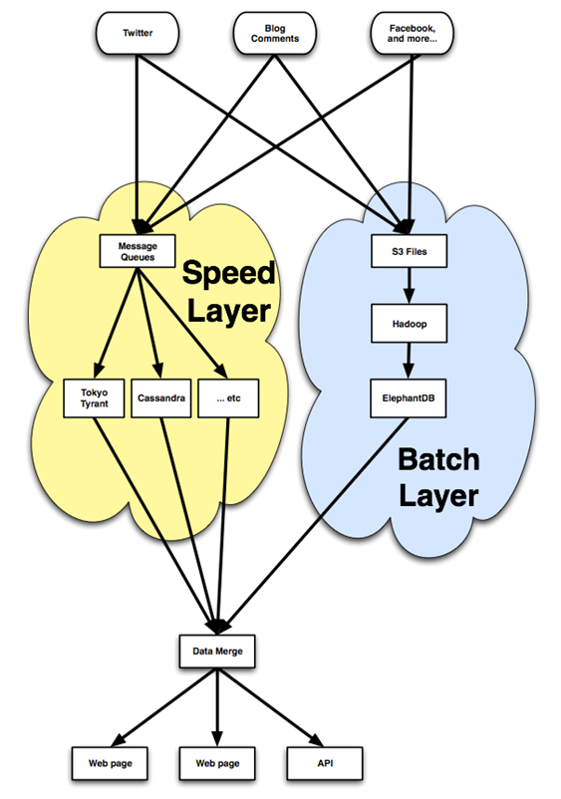
Made for each other: MapReduce + Spot
Use Case: Web crawling/Search using Hadoop type clusters. Use Reserved Instances for their DB workloads and Spot instances for their indexing clusters. Launch 100’s of instances.
Bidding Strategy: Bid a little above the On-Demand price to prevent interruption.
Interruption Strategy: Restart the cluster if interrupted
66% Savings over
On-Demand

Slide 33
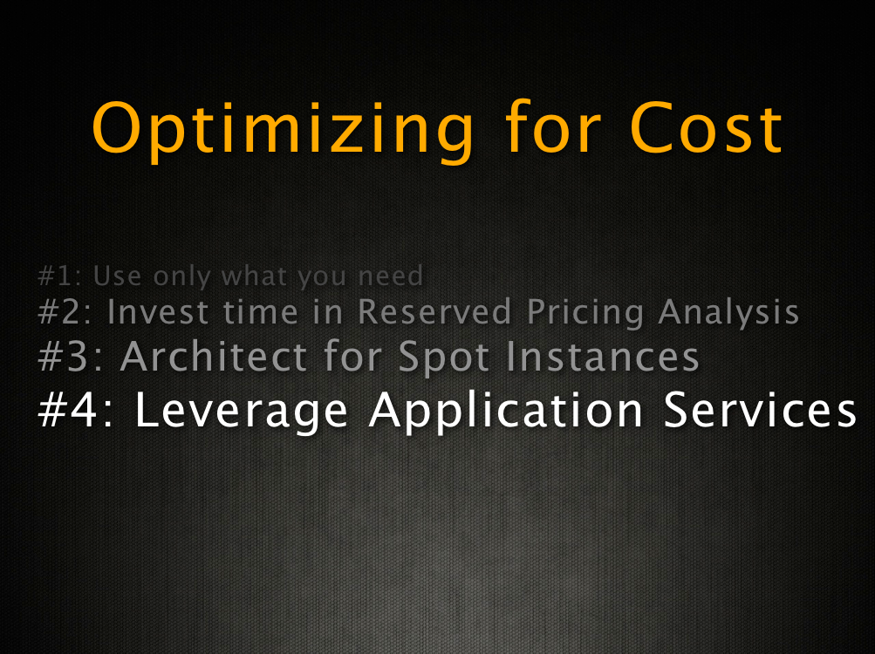

Slide 34
Optimize by converting ancillary instances into services
Monitoring: CloudWatch
Notifications: SNS
Queuing: SQS
Transactional EMail: SES
Load Balancing: ELB
Workflow: SWF
Search: CloudSearch

Slide 35
Elastic Load Balancing
Software LB on EC2
Elastic Load Balancing
Pros
Application-tier load balancer
Cons
SPOF
Elasticity has to be implemented manually
Not as cost-effective
Pros
Elastic and Fault-tolerant
Auto scaling
Monitoring included
Cons
For Internet-facing traffic only (Now Private via VPC)

Slide 36
$0.025 per hour
DNS
Elastic Load Balancer
Web Servers
Availability Zone
vs.
$0.08 per hour
(small instance)
DNS
EC2 instance
+ software LB
Web Servers
Availability Zone

Slide 37
Application Services
Software on EC2
SNS, SQS, SES, SWF
Pros
Custom features
Cons
Requires an instance
SPOF
DIY administration
Pros
Pay as you go
Scalability
Availability
High performance

Slide 38
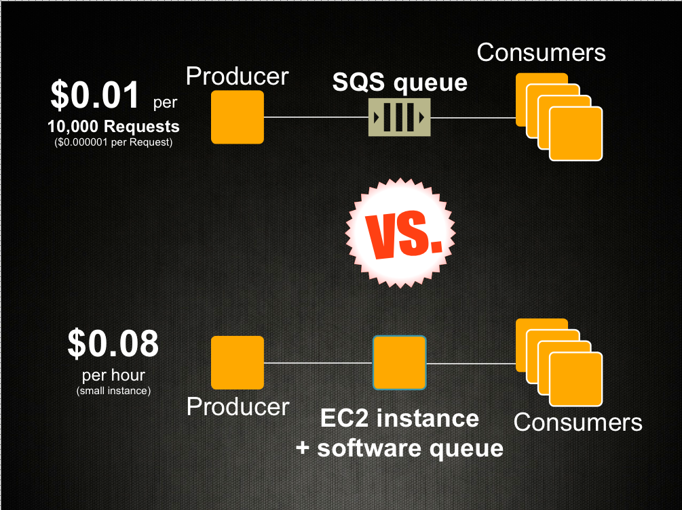

Slide 39
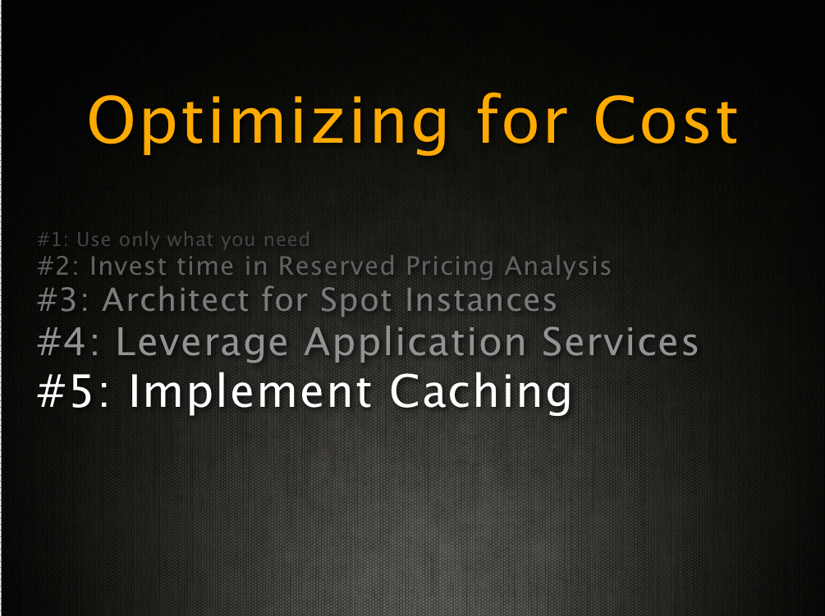

Slide 40

Optimize for performance and cost by page caching and edge-caching static content
caching
Examples:
CloudFront
S3
Varnish
ElastiCache
Storage
Gateway
Even Ephemeral Disk!

Slide 41
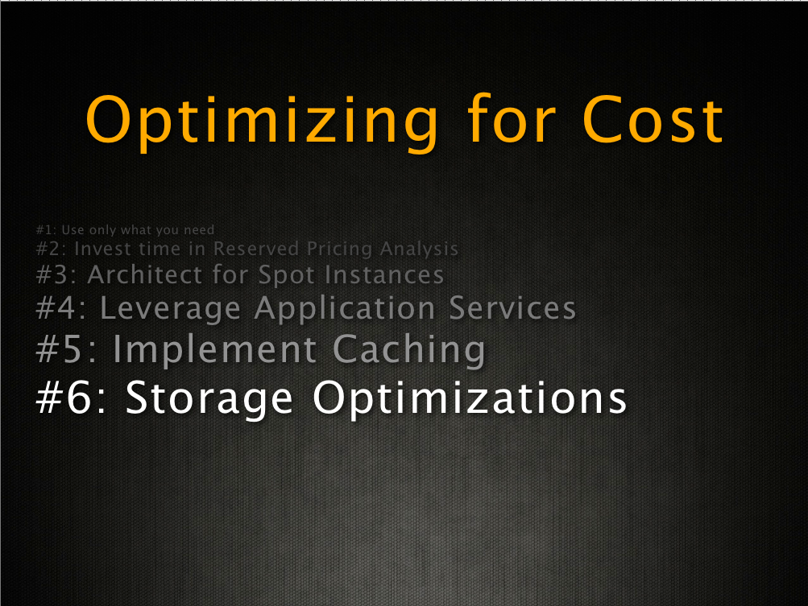

Slide 42
Storage Options
EBS
S3
Ephemeral
Pros
Custom Capacity
Block Storage
Provisioned Perf
Survives Instances
Pros
Granular Cost
Extreme Durability
Offloads Servers
Pros
No Network Needs
Price Included
High performance
Costs scale down as you grow
Reserved Instances save you $ on Ephemeral storage!
Custom provisioning lets you pay for exactly what you use

Slide 43
(Structured) Storage Options
DynamoDB
RedShift
Pros
No Software Cost!
100k IOPS is as easy to deploy as 10 IOPS
Right-sized Storage
Provisioned Performance = Scalable cost
Pros
No Software Cost!
Disruptive $/TB
High performance at High scale
Reuse your SQL Code/Skills/Ecosystem of 3rd Party Tools

Slide 44

Thank you!
Miles Ward - AWS
: @milesward

